Slide 1
Introduction to JavaScript

Slide 2
Topics
What is JavaScript?
Why JavaScript?
Including JavaScript in HTML
Hello World Example Script
JavaScript Comments

Slide 3
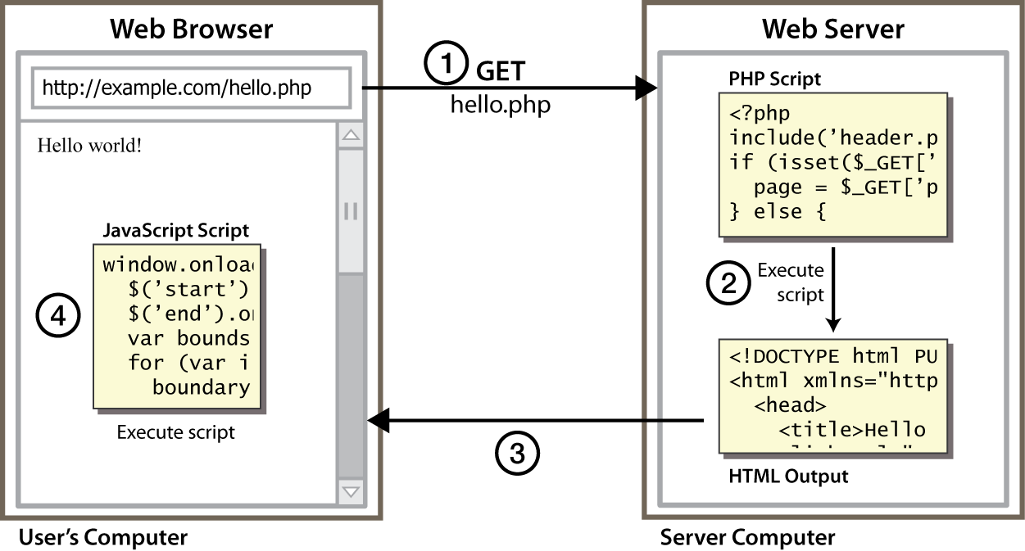
Client Side Scripting
CS380
Notes:
client-side script: code runs in browser after page is sent back from server
often this code manipulates the page or responds to user actions

Slide 4
Why use client-side programming?
PHP already allows us to create dynamic web pages. Why also use client-side scripting?
client-side scripting (JavaScript) benefits:
  usability: can modify a page without having to post back to the server (faster UI)
  efficiency: can make small, quick changes to page without waiting for server
  event-driven: can respond to user actions like clicks and key presses
CS380

Slide 5
Why use client-side programming?
server-side programming (PHP) benefits:
  security: has access to server's private data; client can't see source code
  compatibility: not subject to browser compatibility issues
  power: can write files, open connections to servers, connect to databases, ...
CS380

Slide 6
What is Javascript?
a lightweight programming language ("scripting language")
  used to make web pages interactive
  insert dynamic text into HTML (ex: user name)
  react to events (ex: page load user click)
  get information about a user's computer (ex: browser type)
  perform calculations on user's computer (ex: form validation)
CS380

Slide 7
What is Javascript?
a web standard (but not supported identically by all browsers)
NOT related to Java other than by name and some syntactic similarities
CS380

Slide 8
What is JavaScript?
Created by Netscape
  Originally called LiveWire then LiveScript
A client-side scripting language
  Client-side refers to the fact that it is executed in the client (software) that the viewer is using. In the case of JavaScript, the client is the browser.
  A server-side language is one that runs on the Web server. Examples: PHP, Python
Interpreted on-the-fly by the client
  Each line is processed as it loads in the browser

Slide 9
Why JavaScript?
It’s easier to learn than most programming languages
It allows you to make interactive Web pages
It can be fun!

Slide 10
Including JavaScript in HTML
Two ways to add JavaScript to Web pages
  Use the <script>…</script> tag
  Include the script in an external file -- more about this later in the semester
Initially, we will only use the <script>…</script> tag

Slide 11
Hello, World!
Typically, in any programming language, the first example you learn displays “Hello, World!”
We are going to take a look at a Hello World example and then examine all of its parts.

Slide 12
Hello World in JavaScript
<!DOCTYPE html>
<html>
<head>
<title>Hello World Example</title>
</head>
<body>
<script type="text/javascript">
<!--
document.write("<h1>Hello, world!</h1>");
//-->
</script>
</body>
</html>

Slide 13
JavaScript is not Java
Completely different types of languages that just happen to be similarly named
  JavaScript - programs are interpreted in the browser
  Java - programs are compiled and can be run as stand alone applications

Slide 14

Javascript vs Java
interpreted, not compiled
more relaxed syntax and rules
  fewer and "looser" data types
  variables don't need to be declared
  errors often silent (few exceptions)
key construct is the function rather than the class
  "first-class" functions are used in many situations
contained within a web page and integrates with its HTML/CSS content
CS380

Slide 15


Javascript vs Java
+
=
CS380

Slide 16
JavaScript vs. PHP
similarities:
  both are interpreted, not compiled
  both are relaxed about syntax, rules, and types
  both are case-sensitive
  both have built-in regular expressions for powerful text processing
CS380

Slide 17

JavaScript vs. PHP
differences:
  JS is more object-oriented: noun.verb(), less procedural: verb(noun)
  JS focuses on user interfaces and interacting with a document; PHP is geared toward HTML output and file/form processing
  JS code runs on the client's browser; PHP code runs on the web server
JS <3
CS380

Slide 18
Linking to a JavaScript file: script
<script src="filename" type="text/javascript"></script> HTML
script tag should be placed in HTML page's head
script code is stored in a separate .js file
JS code can be placed directly in the HTML file's body or head (like CSS)
  but this is bad style (should separate content, presentation, and behavior
CS380

Slide 19
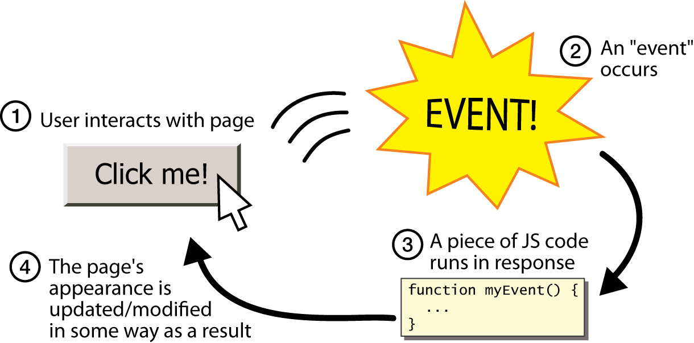
Event-driven programming
split breaks apart a string into an array using a delimiter
  can also be used with regular expressions (seen later)
join merges an array into a single string, placing a delimiter between them
CS380

Slide 20
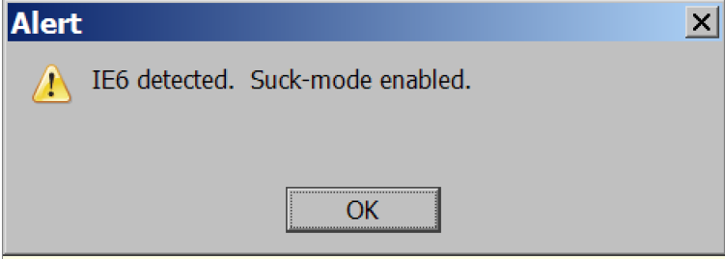
A JavaScript statement: alert
alert("IE6 detected. Suck-mode enabled."); JS
a JS command that pops up a dialog box with a message
CS380

Slide 21
Event-driven programming
you are used to programs start with a main method (or implicit main like in PHP)
JavaScript programs instead wait for user actions called events and respond to them
event-driven programming: writing programs driven by user events
Let's write a page with a clickable button that pops up a "Hello, World" window...
CS380

Slide 22
Buttons
<button>Click me!</button> HTML
button's text appears inside tag; can also contain images
To make a responsive button or other UI control:
  choose the control (e.g. button) and event (e.g. mouse 1. click) of interest
  write a JavaScript function to run when the event occurs
  attach the function to the event on the control
CS380
Notes:
Reset is not working here! Debug! test1.html

Slide 23
JavaScript functions
function name() {
statement ;
statement ;
...
statement ;
} JS
function myFunction() {
alert("Hello!");
alert("How are you?");
} JS
the above could be the contents of example.js linked to our HTML page
statements placed into functions can be evaluated in response to user events
CS380

Slide 24
Event handlers
<element attributes onclick="function();">... HTML
<button onclick="myFunction();">Click me!</button> HTML
JavaScript functions can be set as event handlers
  when you interact with the element, the function will execute
onclick is just one of many event HTML attributes we'll use
but popping up an alert window is disruptive and annoying
  A better user experience would be to have the message appear on the page...
CS380

Slide 25
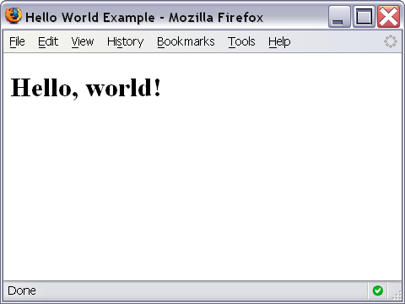
Hello World Screenshot

Slide 26
The <script>…</script> tag
The code for the script is contained in the <script>…</script> tag
<script type="text/javascript">
.
.
.
</script>

Slide 27
Hiding JavaScript from Older Browsers
Some older browsers do not support JavaScript
We need to tell those browsers to ignore what is in the <script> tag
<script type="text/javascript">
<!--
some JavaScript code
//-->
</script>

Slide 28
Displaying text
The document.write() method writes a string of text to the browser
<script type="text/javascript">
<!--
document.write("<h1>Hello, world!</h1>");
//-->
</script>

Slide 29
document.write()
Ends in a semicolon
document.write("<h1>Hello,world!</h1>");
Enclosed in quotes -- denotes a "string"

Slide 30
Comments in JavaScript
Two types of comments
  Single line
    Uses two forward slashes (i.e. //)
  Multiple line
    Uses /* and */

Slide 31
Single Line Comment Example
<script type="text/javascript">
<!--
// This is my JavaScript comment
document.write("<h1>Hello!</h1>");
//-->
</script>

Slide 32
Multiple Line Comment Example
<script type="text/javascript">
<!--
/* This is a multiple line comment.
* The star at the beginning of this line is optional.
* So is the star at the beginning of this line.
*/
document.write("<h1>Hello!</h1>");
//-->
</script>

Slide 33

Find the Bug!
<script type="text/javascript">
<!--
/* This is my JavaScript comment
* that spans more than 1 line.
*
document.write("<h1>Hello!</h1>");
//-->
</script>

